Slide 1
SEC285 Module 5 Multifactor Authentication (MFA)

Slide 2
Rubric
Activity | Requirement(s) | Points
Common-auth Configuration File | Screenshot | 30
MFA Logon Screen | Screenshot | 30

Slide 3
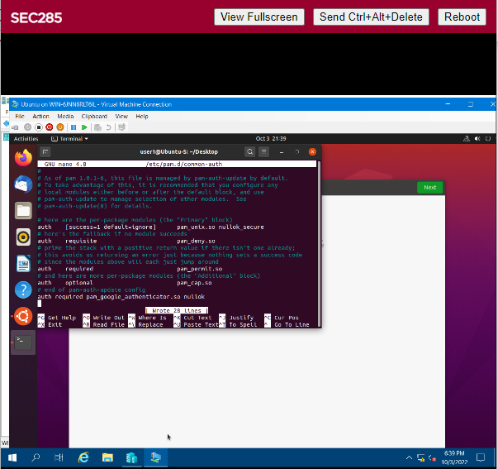
Common-auth Configuration File
This screenshot should show the entry that indicates the use of the Google Authenticator module.

Slide 4
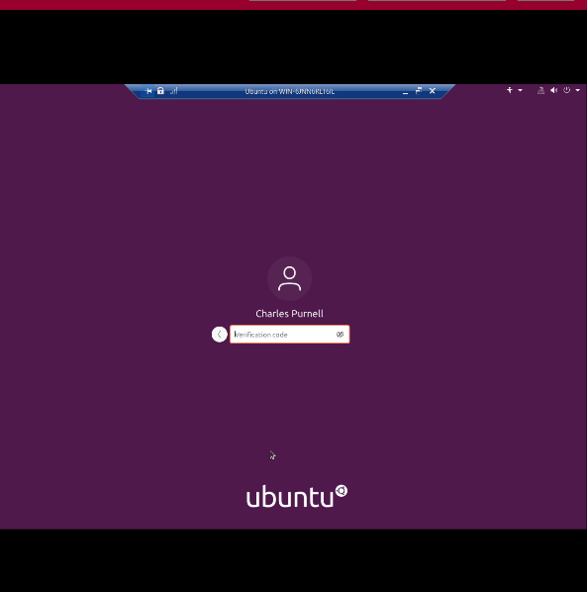
MFA Logon Screen
This screenshot should show the logon screen where a verification code is required.
I ended up changing its name to mine on accident

